Slide 1
Gain structure, Signal to noise ratio, and Dynamic Range
I'm an electronic guy, I'm a freak for electronic music but real instruments, the dynamic range of it, and the emotions, there's no comparison.
Armin van Buuren

Slide 2
Terms
Intermodulary distorion
Clipping
Head room
Noise floor
Nominal level
Dynamic range
Pho-ons/ Loudness curve
SIGNAL to noise ratio-
Mic level/Line Level (again)
Volume
Gain
Signal-EE
Level
Metering and VU meters
Saturation
THREE types of Signal
attenuation:
- Pot, Pad, and Fader
Distortion (peaking)
Harmonic Distortion

Slide 3
Many names for “loudness”
Volume- generic “consumer” term for more sound. Frustratingly vague.
Loudness-Overall sound level
Intensity- Sound pressure level- measured in db SPL
Amplification-Most accurate way to describe making something louder “changing the amplitude”
Gain- Common name for the amplification knob/potentiometer on input channel and Amplifiers ie“to gain amplification” (sometimes called the TRIM pot)
Signal- Audio as electrical energy
Level- means more signal, generic term

Slide 4
and remember we do not hear loudness equally across all frequency ranges

Slide 5
Manipulating Amplitude/Gain…
3 main ways to control volume or gain:
-Pots (gain knobs/trim knobs)
-Faders (input and output faders)
-Pad buttons (20db approx) or switches (sometimes mic vs line input switch depending on how inputs are set up)

Slide 6
Gain structure:
Enough SIGNAL without overdriving the gear at each point in your sound system
Attempt at an analogy/graphic reference:
Coffee, like good audio is great,
but if your cup isn’t big enough
(speakers and amplifiers/over all gain in
your system), all you
get is mess (distortion etc...)

Slide 7
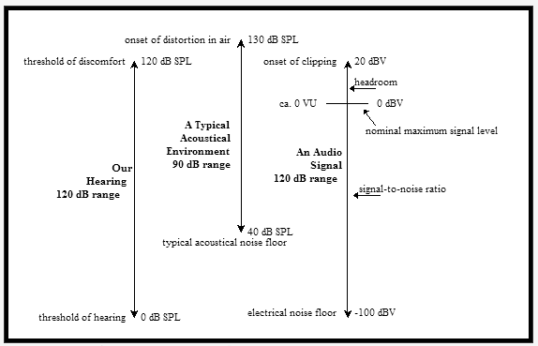
Dynamic range
-Quietest to loudest sound, measured in db

Slide 8
Typical dynamic ranges

Slide 9
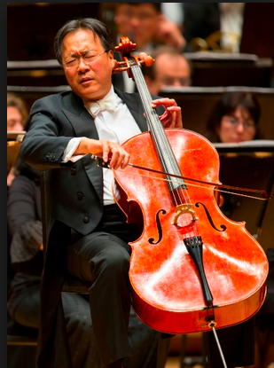
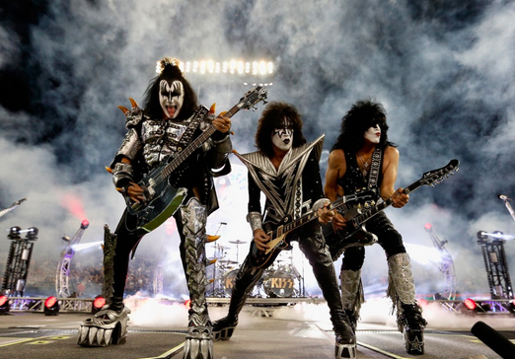
Ideally you want to set up your gain structure to accommodate the “dynamic range” of your program audio:
How would the dynamic ranges of these performers vary?

Slide 10
Why is this important
Having the right sound system to accurately replicate the dynamic range of your audio
TO avoid Overdriving inputs and outputs and making them clip and distort
TO avoid covering up Quiet passages in the music because they are below the electrical noise floor

Slide 11
How this is measured?
dB (outputs)
dBm (in console)
dB u/v (in console)
dBW (in gear)
dB SPL (measured with a meter in the house)

Slide 12
Noise floor, Nominal level, Peak Level, and Headroom.

Slide 13
Noise and unwanted sound
ROOM TONE: anything generating consistent, not part of the concert/recording/ie wanted signal you are recording or amplifying
NOISE : “un harmonically organized” sound (and typically UN WANTED sound)
Make sure your system can amplify the “quietest sound” in your audio, above that NOISE FLOOR.

Slide 14
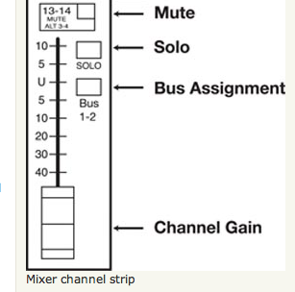
Nominal level
Average audio program level
Typically “0” or “U”
(for “unity”) on
The fader strip
-Should be substantially
Above the bottom of the
Fader to avoid the noise
floor

Slide 15
Peak level
The LOUDEST sound in your audio.
Any sound above it will Clip or distort (and possibly damage) your audio gear
ALWAYS establish the LOUDEST sound in your program audio to insure your system can drive that much signal/level, without damaging your gear

Slide 16
Headroom
The space between nominal and peak
How much you need is dependent on what type of audio you are amplifying. How big is the db difference between average and peak level in your audio?

Slide 17
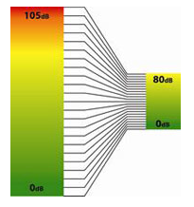
And if your sound system/channel strip CAN’T Generate that dynamic range: Compression can help
https://www.dropbox.com/s/kyp6zpd913jt717/Screenshot%202015-09-23%2012.43.27.png?dl=0

Slide 18
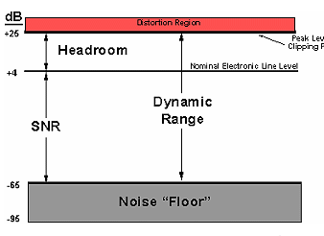
Metering: Indicator or VU meters found multiple places in the signal chain
Vu meters: Green/yellow/RED!

Slide 19
Vu meter (old school)

Slide 20
Vu meter (typical)

Slide 21
Typical metering
Green: Noise floor up to Nominal
Yellow: Nominal- peak level (headroom)
Red: overdriving gear (will begin distorting audio gear)*
*note, much professional audio gear will leave some additional db of head room above peaking, but it is always good to avoid possible clipping

Slide 22
Signal to noise ratio
-VERY important in recording and live performance
-the Ratio of WANTED sound (signal ie your performer at the microphone) to UNWANTED sound (NOISE)
-Noise floor of a sound system is also defined as “the level of sound you would here if you removed the signal”

Slide 23
Signal to noise cont.
When you add 20db of amplification to your Signal, YOU ALSO ADD 20 dB of amplification to your NOISE FLOOR

Slide 24
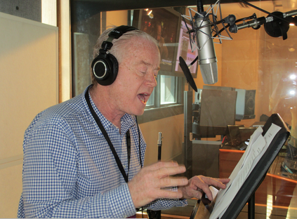
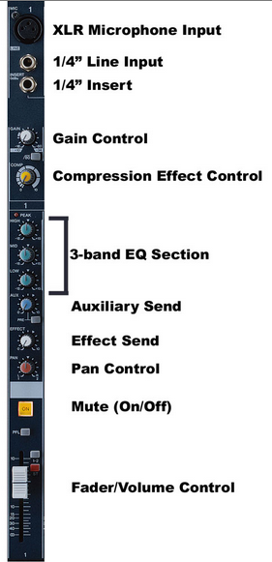
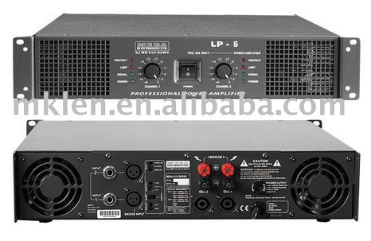
#1 Best place to start to get a good signal to noise ratioFirst
# 2 Best place to start to get a good signal to noise ratioFirst
#3 Best place to set overall gain/maximum sound level once you have saturated inputs and outputs. Start conservative and use as a global control if needed.irst
#2 a (use along with above)irst

Slide 25
Noise can also come from gear in a variety of ways:
EMI-electromagnetic waves picked up by the system and amplified from: power lines, fluorescent lamps, computers, solid state light dimmers etc. etc.
RFI-radio frequency transmissions picked up by audio systems and amplified
Poor shielding (low power audio lines, high power power lines)
ground loops

Slide 26
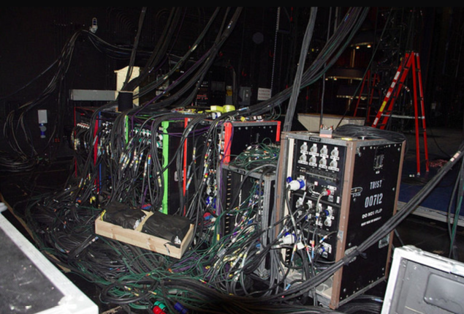
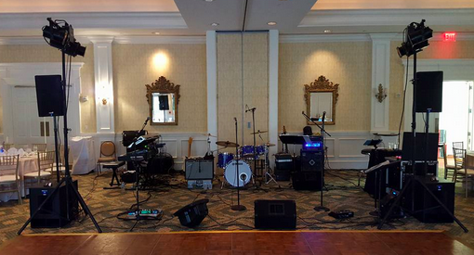
If these are your backstage/onstage set ups is emi noise possible? Why?

Slide 27
Some typical kinds of noise…
Hum (often low frequency noise picked up by recording?)
Hiss (cheap gear, frequency specific noise)
Buzz =60 hz (ground loop) hum from power, try to use isolated power or ground lift it.
WE WILL talk more about this in electricity in audio

Slide 28
Distortion
2 major types:
HD: Harmonic Distortion, most common (one type is called “clipping”)
IM: Intermodulary Distortion

Slide 29
Distortion sound “rough/jagged” because of added frequencies NOT in original sound
HARMONIC DISTORTION: harmonics added to the sound
100hz tone adds in 200hz, 300hz, 400hz…etc
- CLIPPING is a type of Harmonic distortion
Intermodulary Distortion: additives and differences added in
100 hz and 900hz tones result in IM distortion at
1000hz and 800hz

Slide 30
Terms
Intermodulary distorion
Clipping
Head room
Noise floor
Nominal level
Dynamic range
Pho-ons/ Loudness curve
SIGNAL to noise ratio-
Mic level/Line Level (again)
Volume
Gain
Signal-EE
Level
Metering and VU meters
Saturation
THREE types of Signal
attenuation:
- Pot, Pad, and Fader
Distortion (peaking)
Harmonic Distortion

